Slide 1

Ethics
A Samuel Pottinger
Stat 198: IDSV
April 21, 2025

Slide 2
Today
> Lenses on the World
Encodings
Possibility Space (Action)
Possibility Space (Narrative)
Agency

Slide 3
Pause
Today might be a little rough and a little fast. This is a space to explore complex feelings about difficult questions.

Slide 4
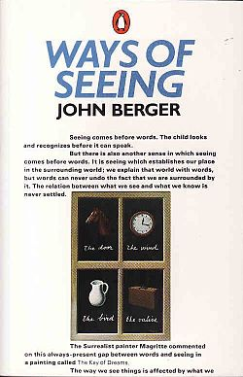
Why discuss ethics in data visualization?
We are creating a “way of seeing” in which we necessarily must make decisions about how others are represented and how users interact with an audience which may not be present.
This seems at first to be just about visual representation but this is deep in the heart of technology, including AI.
Notes:
https://en.wikipedia.org/wiki/Ways_of_Seeing#/media/File:Waysofseeingcvr.jpg

Slide 5

It’s everywhere
Notes:
https://youtu.be/AaU6tI2pb3M?feature=shared

Slide 6
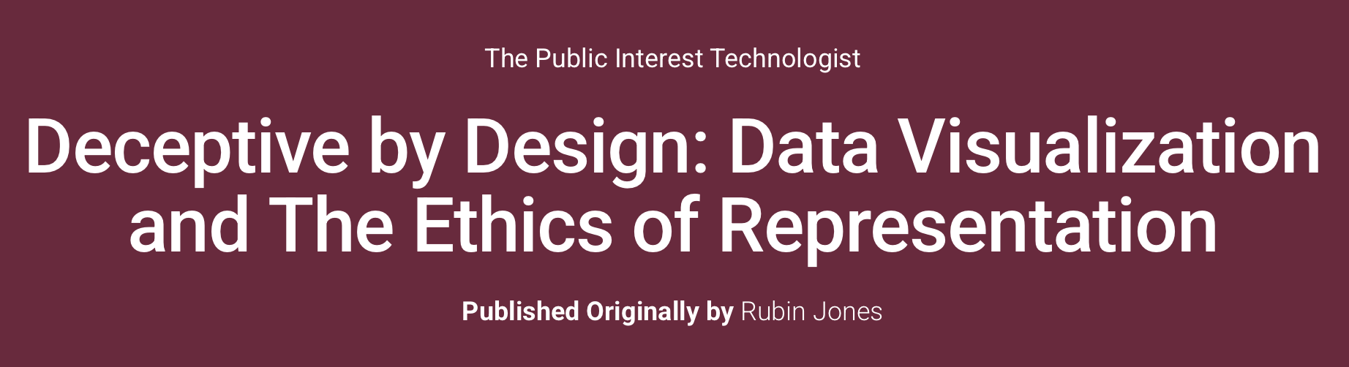
Digging in deeper: Jones
“It is tempting to think of data and visualization as a neutral actor, with a single ‘correct’ set of design choices that ‘truthfully’ report the data. However, outside of egregious errors (e.g., when dates are sorted incorrectly or the y-axis is not scaled uniformly), we see that ‘ground truth’ in data is much more contextual and situated. Design choices we make give visualization a rhetorical power that influences what a reader concludes and remembers about the data, and blurs the line between persuasion and deception.”
Notes:
https://technologist.mit.edu/deceptive-by-design-data-visualization-and-the-ethics-of-representation/

Slide 7
Digging in deeper: Jones
We have a certain degree of power as designers.
Notes:
https://technologist.mit.edu/deceptive-by-design-data-visualization-and-the-ethics-of-representation/

Slide 8
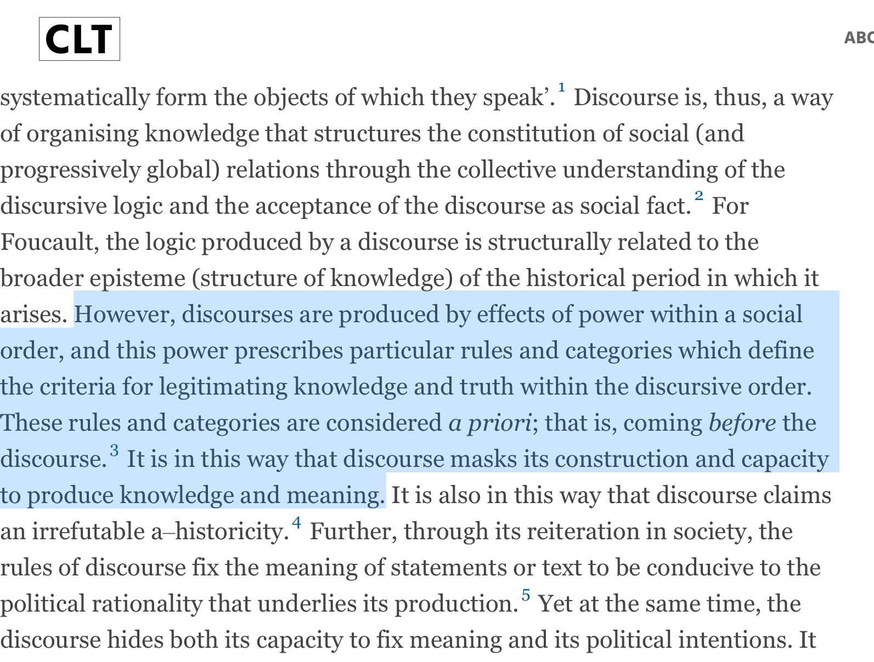
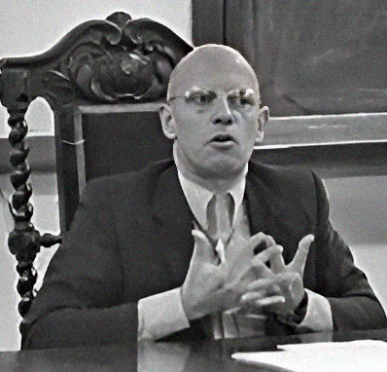
Digging in deeper: Foucault
Notes:
https://en.wikipedia.org/wiki/Michel_Foucault#/media/File:Michel_Foucault_1974_Brasil.jpg
https://criticallegalthinking.com/2017/11/17/michel-foucault-discourse/

Slide 9
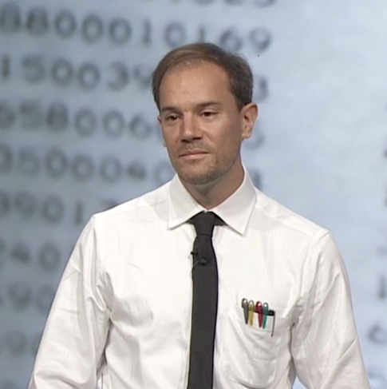
Digging in deeper: Victor
Think back to Media for Thinking the Unthinkable: the medium changes what is possible to think altogether.
Notes:
https://en.wikipedia.org/wiki/Bret_Victor
https://vimeo.com/67076984

Slide 10
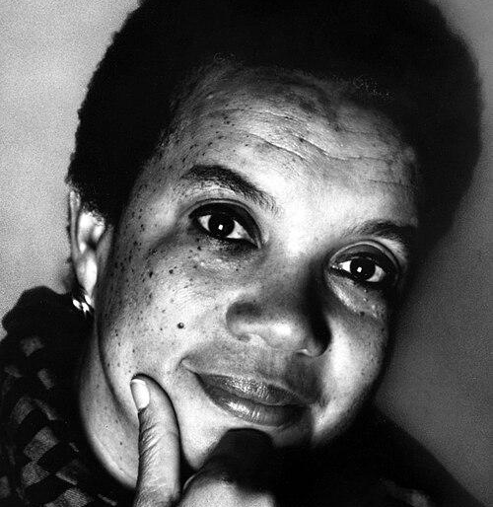
Digging in deeper: Edelman
You can’t be what you can’t see.

Slide 11
Digging in deeper
Unlike some other forms of technology, these choices in data visualization are often more explicit.
We have outlined the steps in which these choices are made: encoding devices, user actions, ludonarrative, possibility space.
However, we are choosing reality. We are choosing representation.

Slide 12
Today
Lenses on the World
> Encodings
Possibility Space (Action)
Possibility Space (Narrative)
Agency

Slide 13
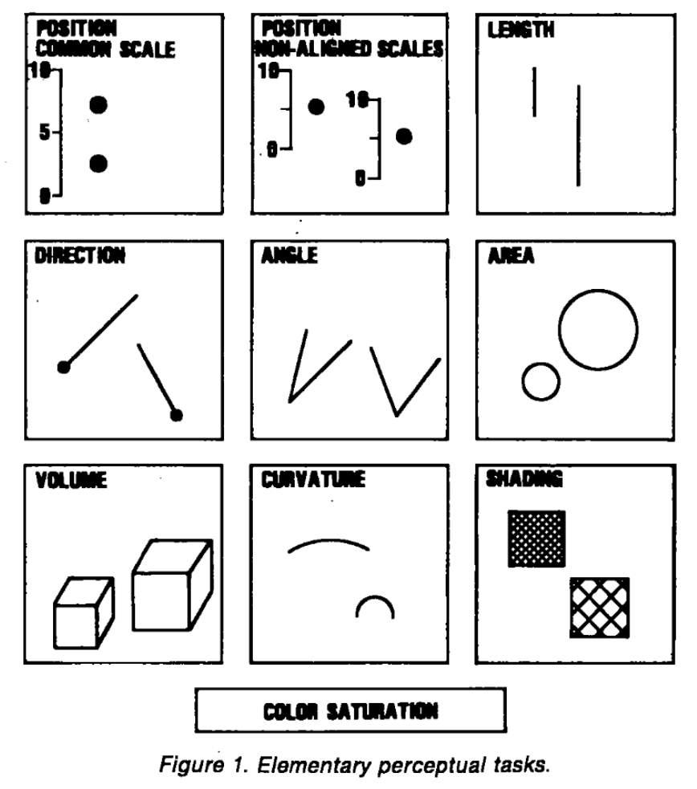
Why do we choose certain encodings?
Go back to Cleveland and McGill.
We originally framed encoding devices as a series of mapping where we put the “most important” variables in the highest encodings.
However, what are the most important variables? What leads you to making that decision?

Slide 14
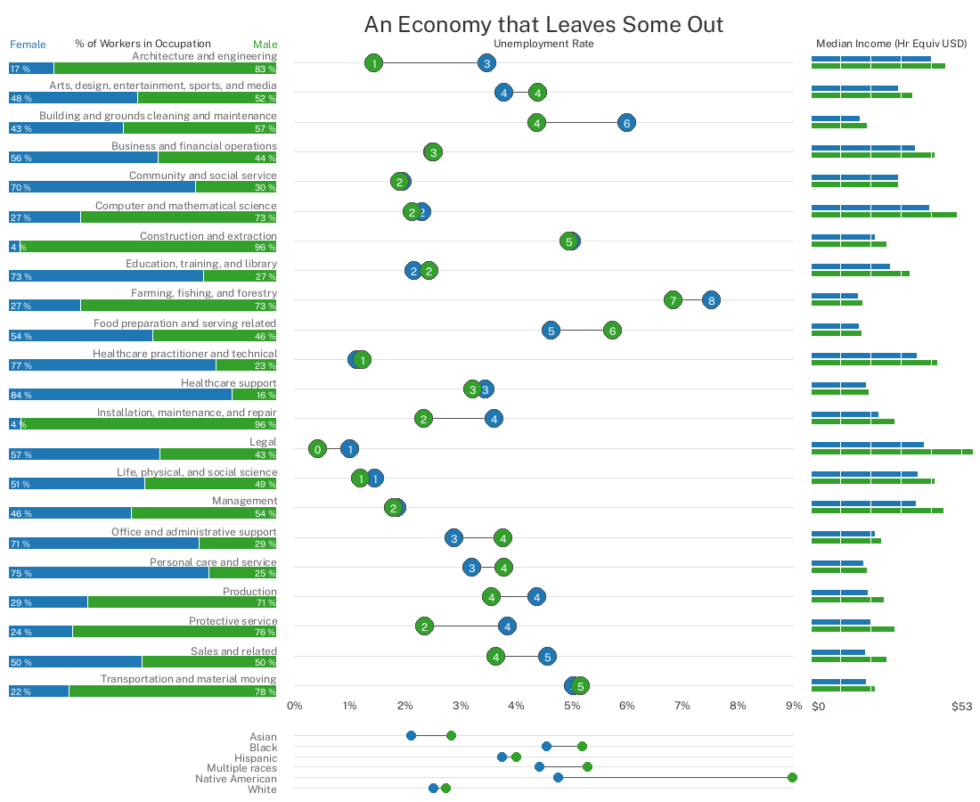
Why do we choose certain encodings?
However, what are the most important variables? What leads you to making that decision?

Slide 15
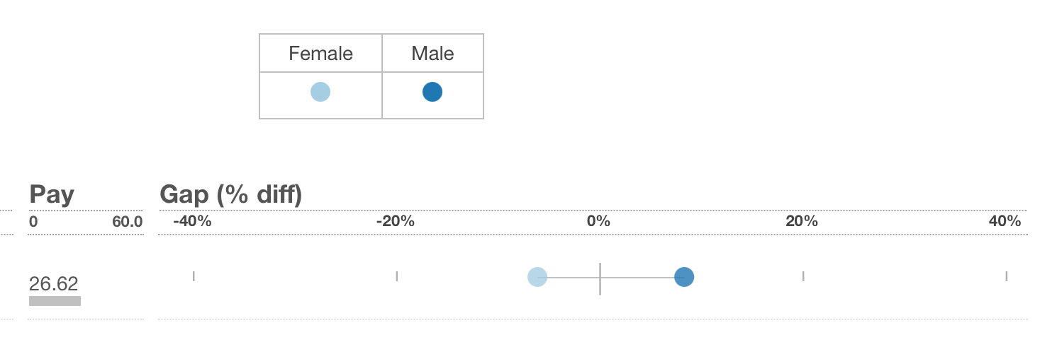
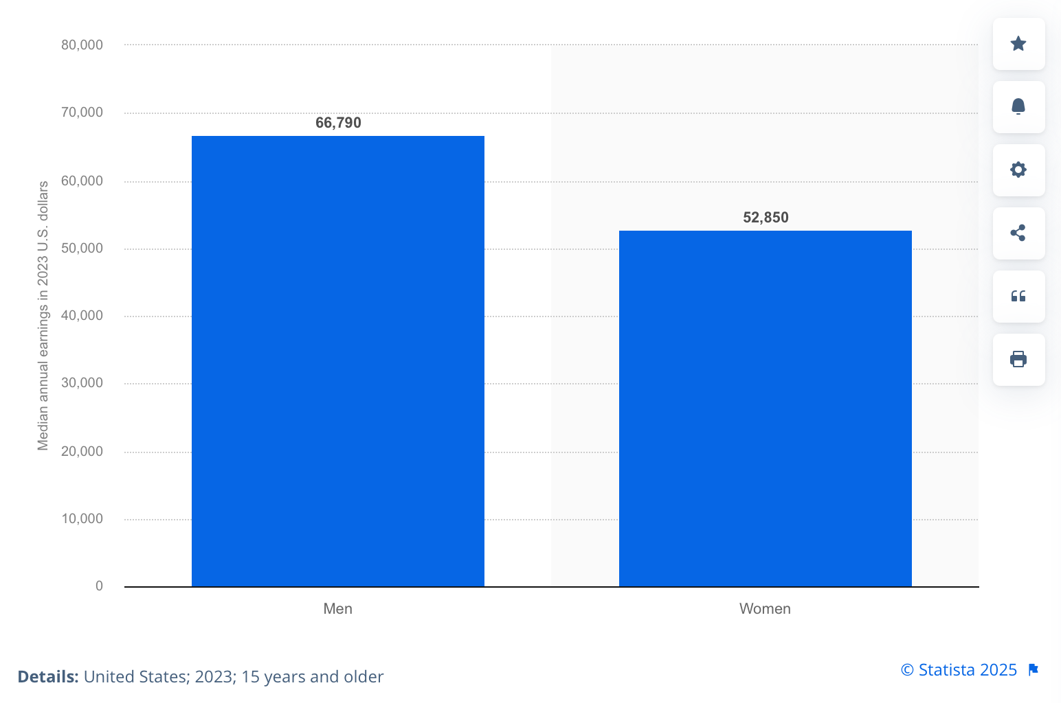
How are we choosing the baseline?
We’ve spoken about issues with broken axes before but why is that a problem? What choice is embedded in doing something other than distance from zero? Is that always the right choice?
Notes:
https://incomegaps.com/?variable=income.median&dimension=female&filters=11111111111111111111111111110100&config=0011
https://www.statista.com/statistics/1186135/us-median-annual-worker-earnings-by-gender/

Slide 16
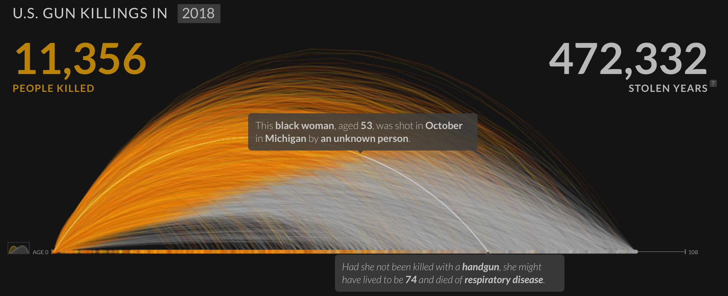
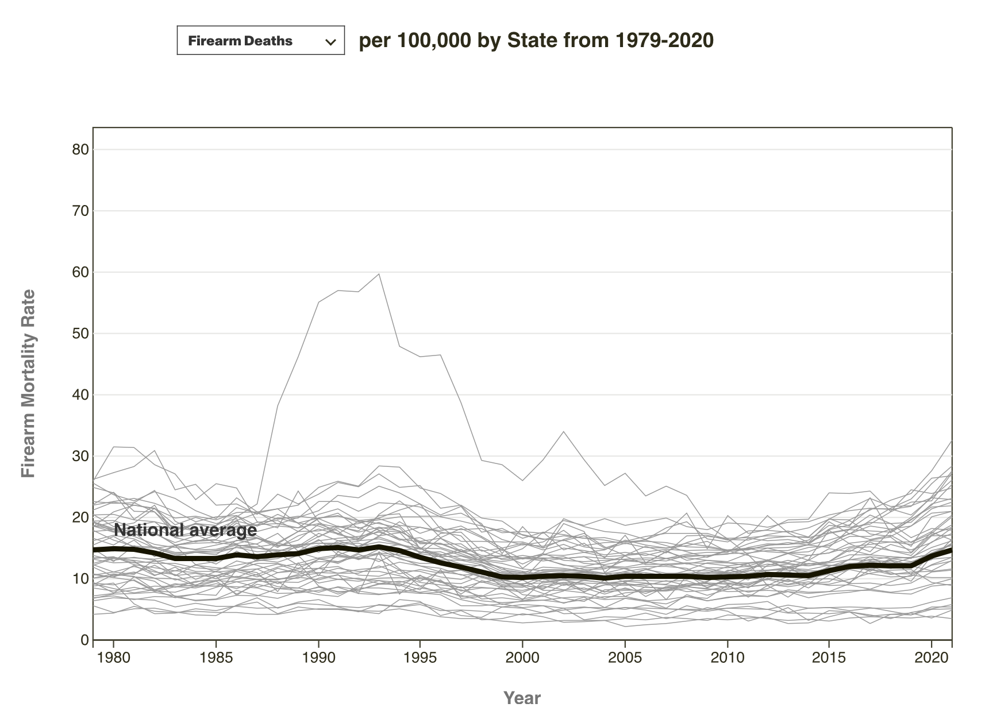
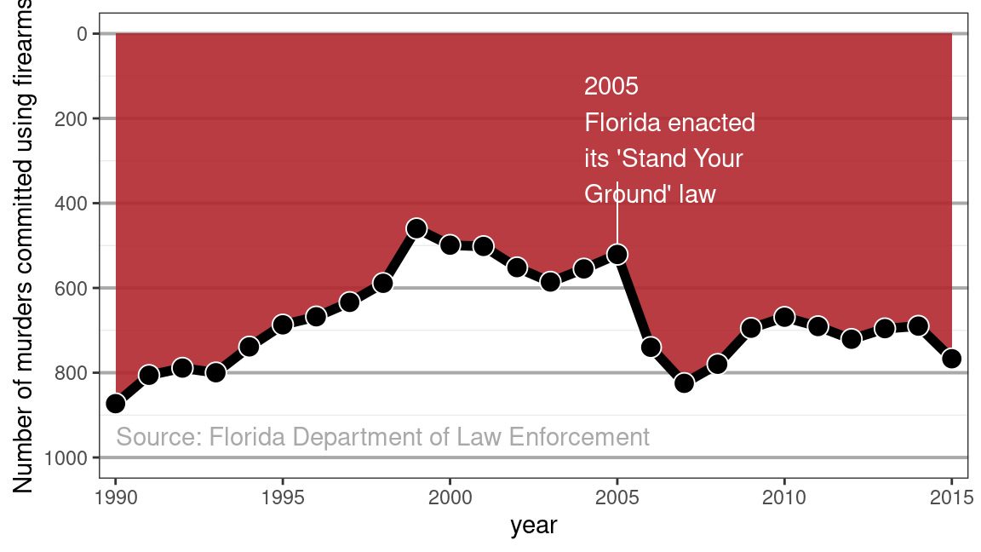
Visual design isn’t neutral.
Let’s revisit three treatments of gun deaths? Which is the most ethical?
Notes:
https://mdsr-book.github.io/mdsr2e/ch-ethics.html
https://guns.periscopic.com/
https://www.rand.org/research/gun-policy/longitudinal-firearm-mortality.html

Slide 17
Today
Lenses on the World
Encodings
> Possibility Space (Action)
Possibility Space (Narrative)
Agency

Slide 18
What actions are allowed and why?
Let’s reconsider possibility space: it defines what questions we can and cannot ask.

Slide 19
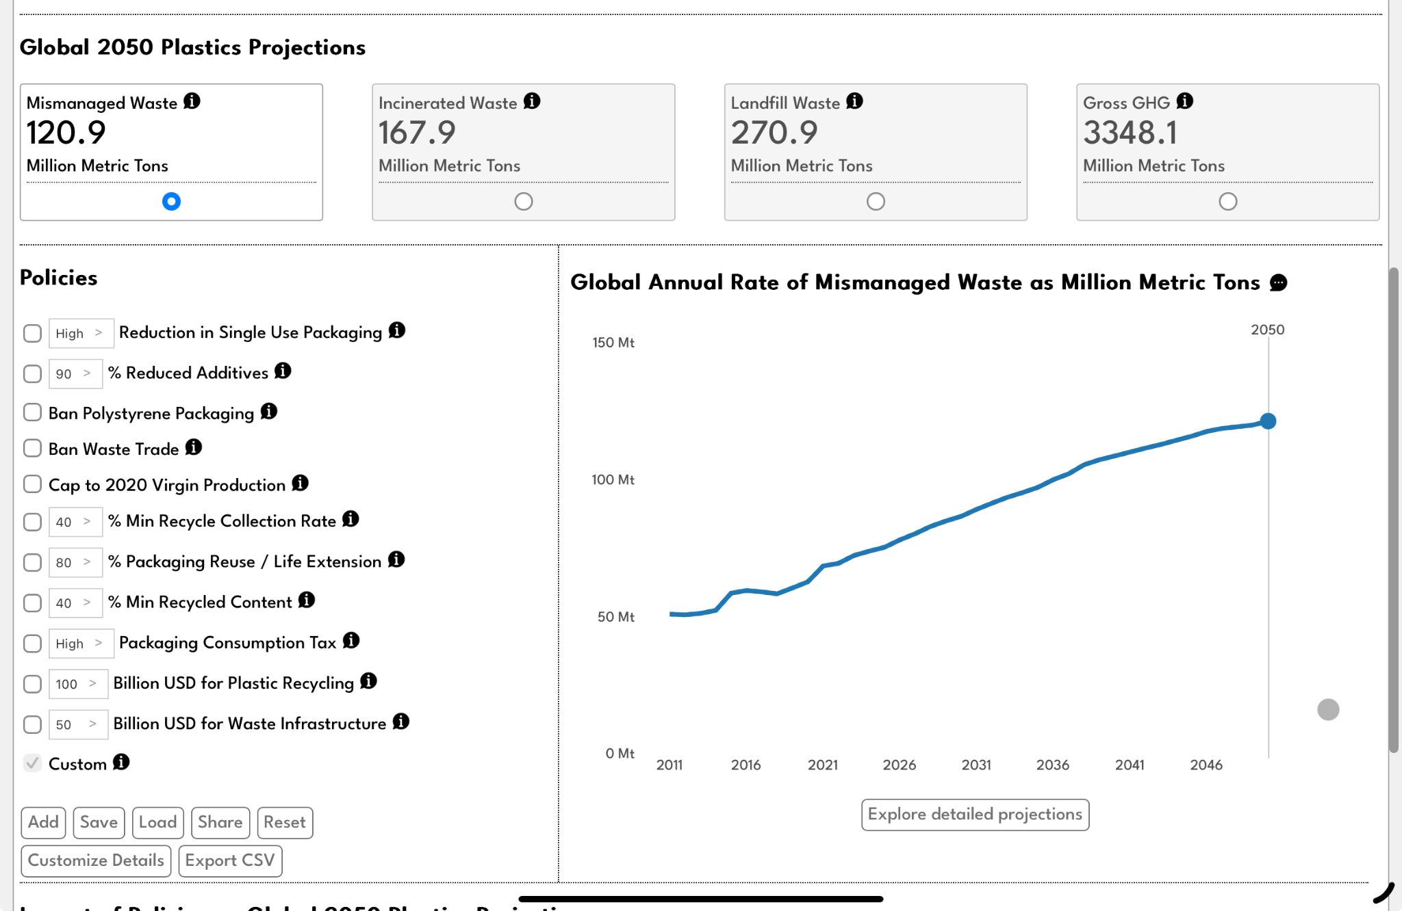
What is the possibility space?
Think about your visualizations as well. Why did you choose your actions?
These choices are unavoidable.

Slide 20
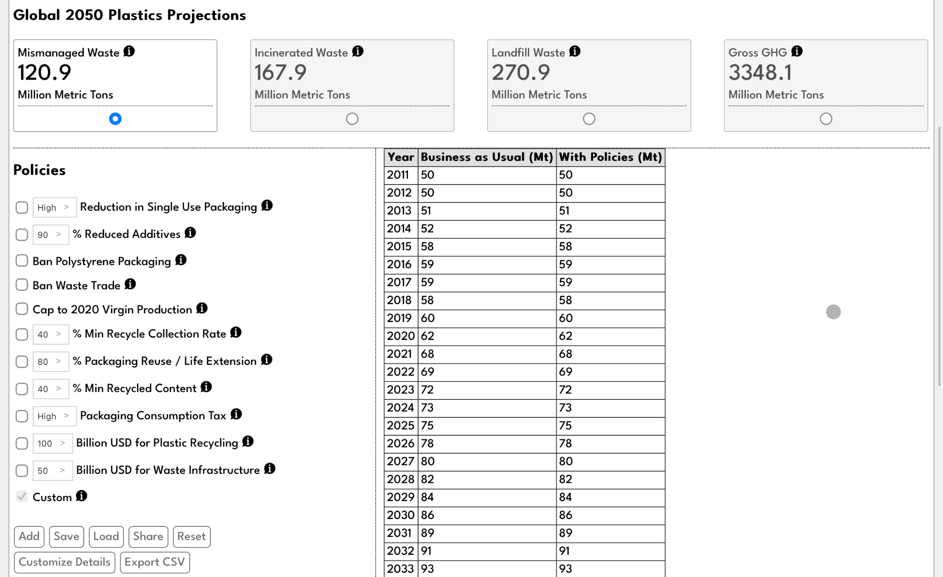
Is the full possibility space accessible?
We skirted some deep ethical questions about accessibility but let’s take those head on.
How we are warping the possibility space in our accessibility profile?

Slide 21
Today
Lenses on the World
Encodings
Possibility Space (Action)
> Possibility Space (Narrative)
Agency

Slide 22
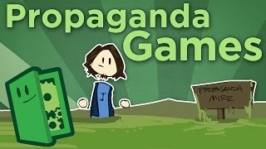
A look at games
Notes:
https://youtu.be/UP4_bMhZ4gA?feature=shared

Slide 23
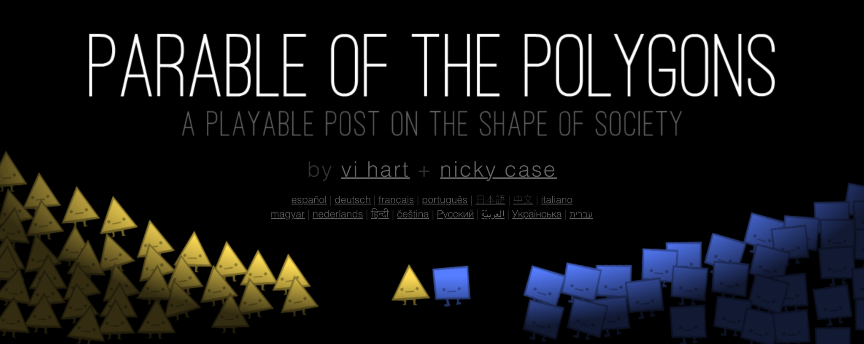
Discussion of Parable of the Polygons
What is gained and what is lost through abstraction?
Notes:
https://ncase.me/polygons/

Slide 24
Today
Lenses on the World
Encodings
Possibility Space (Action)
Possibility Space (Narrative)
> Agency

Slide 25
What does user agency mean?
How are we choosing what is good and what is bad?
How are we choosing what is visible and what is invisible?
How are we choosing what is possible to think?
How would those we are representing feel about that representation?

Slide 26
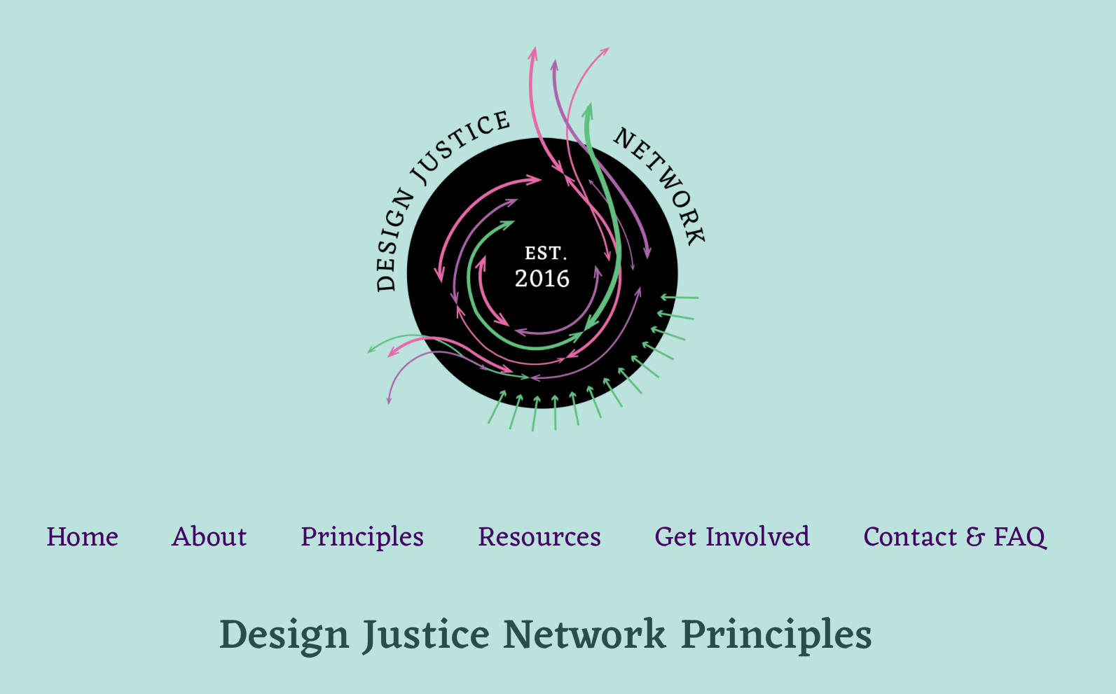
One last resource
https://designjustice.org/
read-the-principles

Slide 27
This doesn’t need to be negative
Broaden the perspective of who is an author.
These choices are essential, make them wisely.
Think about which narratives are elevated or diminished.
There is no formula to get to a right or wrong answer. We have think critically. We have to do the work.

Slide 28
Works cited
A. Shatov, "White Digital Device at 12 00," Unsplash, 2021. Available: https://unsplash.com/photos/white-digital-device-at-12-00-DHl49oyrn7Y
J. Berger, Ways of Seeing, Penguin Books, 1972. Image: https://en.wikipedia.org/wiki/Ways_of_Seeing#/media/File:Waysofseeingcvr.jpg
R. Jones, "Deceptive by Design: Data Visualization and The Ethics of Representation," MIT. Available: https://technologist.mit.edu/deceptive-by-design-data-visualization-and-the-ethics-of-representation/
Wikipedia Contributors, "Ciclo de conferências do filósofo francês Michel Foucault, no Hospital das Clínicas da Universidade do Estado da Guanabara (UEG)," Wikimedia Foundation. Available: https://en.wikipedia.org/wiki/Michel_Foucault#/media/File:Michel_Foucault_1974_Brasil.jpg
W. Pragher, "Photograph of Martin Heidegger," Wikimedia Foundation. Available: https://en.wikipedia.org/wiki/Martin_Heidegger#/media/File:Heidegger_2_(1960).jpg
R. Adams, "Michel Foucault: Discourse," Critical Legal Thinking, 2017. Available: https://criticallegalthinking.com/2017/11/17/michel-foucault-discourse/
Wikipedia Contributors, "Bret Victor." Wikimedia Foundation, Inc., Jun. 22, 2023. Available: https://en.wikipedia.org/wiki/Bret_Victor
B. Victor, "Media for Thinking The Unthinkable," MIT Media Lab, 2013. Available: https://vimeo.com/67076984
CDC, "Marian Write Edelman," Wikimedia Foundation. Available: https://en.wikipedia.org/wiki/Marian_Wright_Edelman#/media/File:Marian_Wright_Edelman_01.jpg
M. Edelman, "You can't be what you can't see," Goodreads. Available: https://www.goodreads.com/quotes/536048-you-can-t-be-what-you-can-t-see
A. Thorn, "AI is an Ethical Nightmare," Philosophy Tube, 2023. Available: https://www.youtube.com/watch?v=AaU6tI2pb3M
W. S. Cleveland and R. McGill, "Graphical Perception: Theory, Experimentation, and Application to the Development of Graphical Methods," Journal of the American Statistical Association, vol. 79, no. 387, pp. 531–554, Sep. 1984, doi: 10.1080/01621459.1984.10478080.
A. Pottinger, "Income Gaps." 2023. Available: https://incomegaps.com/
A. Tierney, "Median annual earnings of full-time workers in the United States in 2023, by gender," Statista, 2024. Available: https://www.statista.com/statistics/1186135/us-median-annual-worker-earnings-by-gender/
B. Baumer, D. Kaplan, and N. Horton, Modern Data Science with R, 2nd Ed, CRC Press, 2021.
K. Rees and Periscopic, "U.S. Gun Deaths." Periscopic, 2018. Available: https://guns.periscopic.com/
K. Sumah, L. Floyd, and H. McCracken, "Changes in State Firearm Mortality," Rand Corporation, 2024. Available: https://www.rand.org/research/gun-policy/longitudinal-firearm-mortality.html
A. Pottinger, R. Geyer, N. Biyani, C. Martinez, N. Nathan, M. Morse, M. de Bruyn, C. Boettiger, E. Baker, K. Koy, and D. McCauley, "Global Plastics AI Policy Tool," University of California, 2024. Available: https://global-plastics-tool.org/
A. Pottinger, R. Geyer, N. Biyani, C. Martinez, N. Nathan, M, Morse, C. Liu, S. Hu, M. de Bruyn, C. Boettiger, E. Baker, and D. McCauley, "Pathways to reduce global plastic waste mismanagement and greenhouse gas emissions by 2050," Science, 2024. doi: 10.1126/science.adr3837
J. Portnow, "Propaganda Games - Ethical Game Design," Extra Credits, 2012. Available: https://www.youtube.com/watch?v=UP4_bMhZ4gA
V. Hart and N. Case, "Parable of the Polygons," Nicky Case, 2022. Available: https://ncase.me/polygons/
Design Justice Networ, "Design Justice Network Principles," Design Justice Network, 2018. Available: https://designjustice.org/read-the-principles

Slide 29
